Slide 1
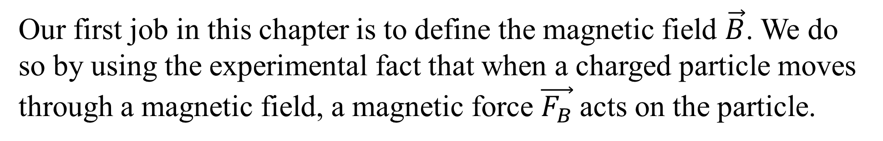
Chapter Eight
Magnetic Fields
Our first job in this chapter is to define the magnetic field $\vec{B}$. We do so by using the experimental fact that when a charged particle moves through a magnetic field, a magnetic force $\vec{F_{B}}$acts on the particle.
Notes:
A closely related goal is the study of how a magnetic field can produce a magnetic force on a (moving) charged particle or on a magnetic object such as a magnet.

Slide 2




6-5
CYCLOTRONS AND SYNCHROTRONS
6-6
MAGNETIC FORCE ON A CURRENT-CARRYING WIRE

Slide 3
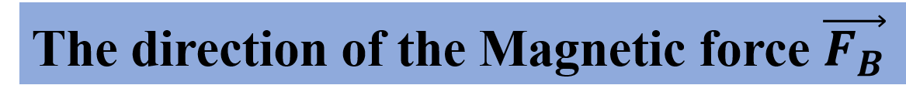

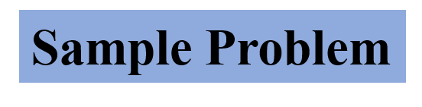
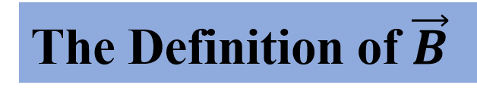
We have learnt how an electric field can produce an electric force on a charged object. Here, we will learn how a magnetic field can produce a magnetic force on a (moving) charged .
Notes:
The applications of magnetic fields and magnetic forces are countless and changing rapidly every year.
Entertainment industry depended on the magnetic recording of music and images on audiotape and videotape.
The industry still depends on the magnets that control CD and DVD players and computer hard drives; magnets also drive the speaker cones in headphones, TVs, computers, and telephones.
A modern car comes equipped with dozens of magnets because they are required in the motors for engine ignition, automatic window control.

Slide 4
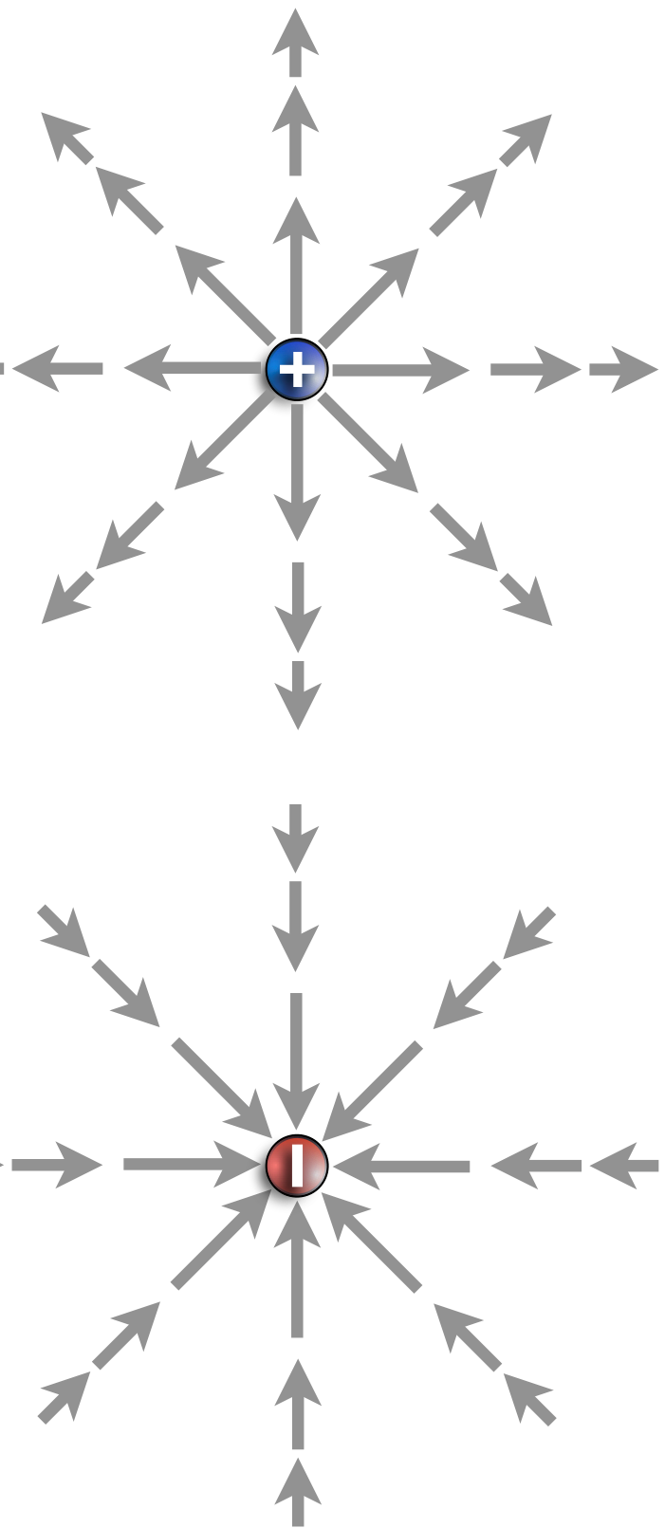
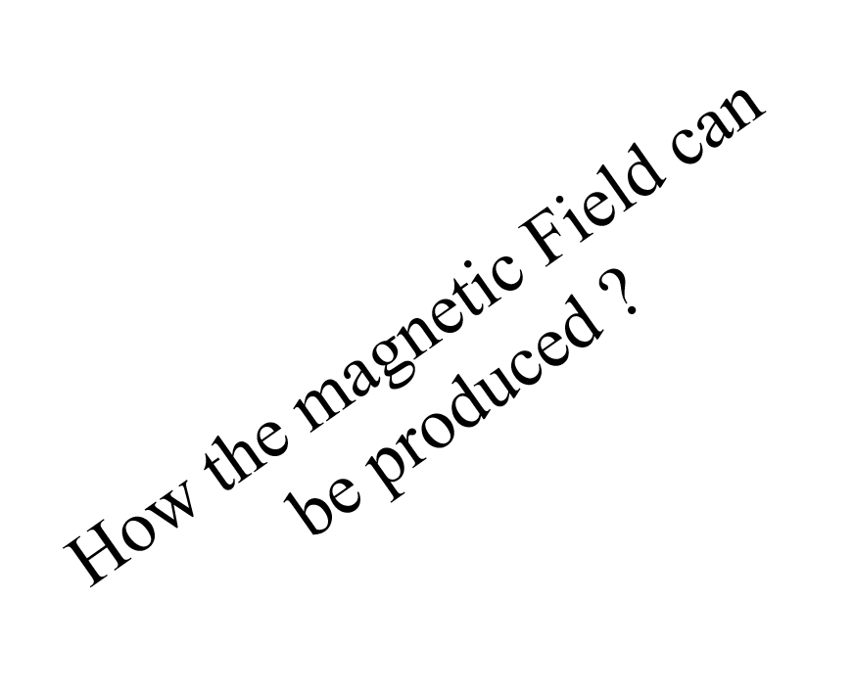
Electric Field produces by electric charge
Magnetic Field produces by ??
no magnetic charge
Monopole
Notes:
As you have learnt from Electric Field chapter that the E can be produced in the present of either positive or negative charge, it is called Monopolar. Most of you maybe expect same thing, that the magnetic field is produced by a magnetic charge. But in fact there is no magnetic charge, it is not exist.
The question will be risen.

Slide 5
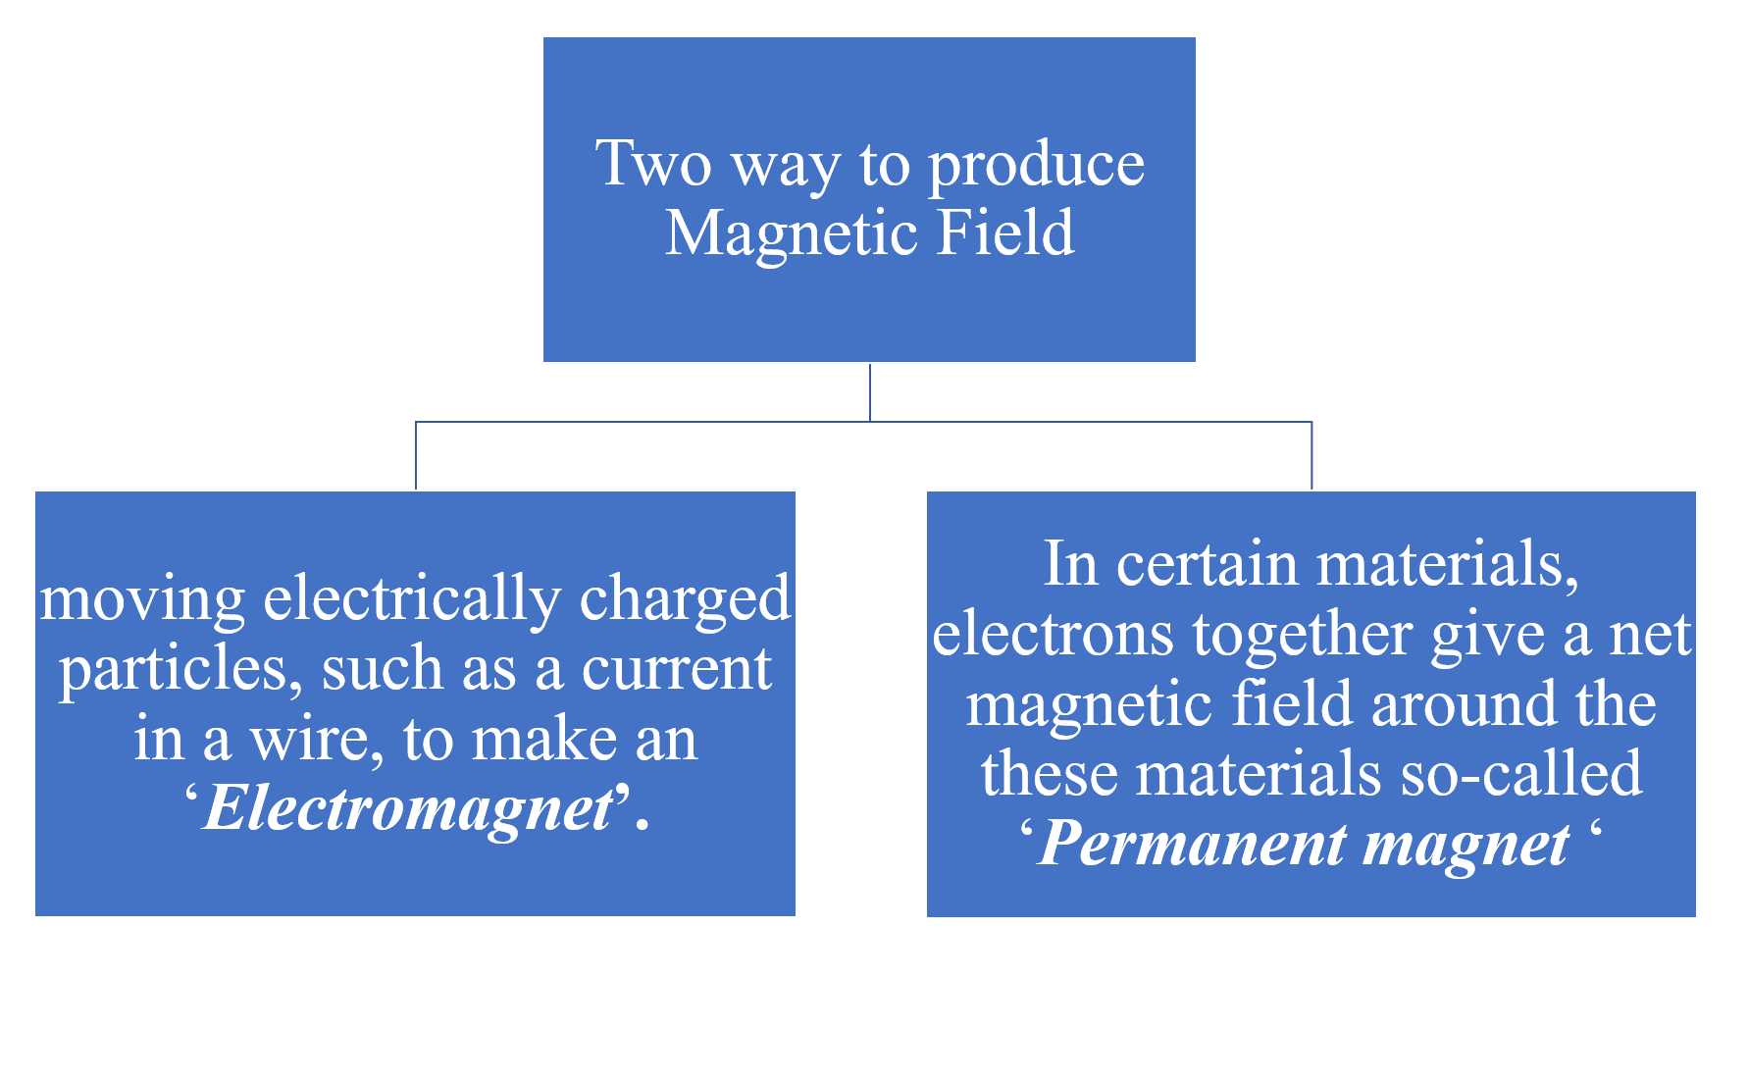
The current produces a magnetic field that can be used, for example, to control a computer hard drive or to sort scrap metal
In other materials, the magnetic fields of the electrons cancel out, giving no net magnetic field surrounding the material. Such cancellation is the reason you do not have a permanent field around your body
Notes:
The other way to produce a magnetic field is by means of elementary particles such as electrons because these particles have an intrinsic magnetic field
around them. In certain materials the magnetic field of the electrons add together to give a net magnetic field around that materials. However, the magnetic fields of the electrons cancel out, giving no net magnetic field surrounding the material.

Slide 6
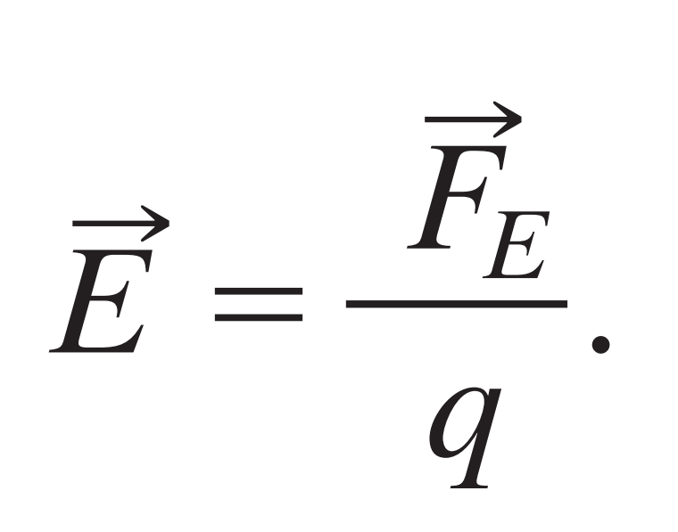
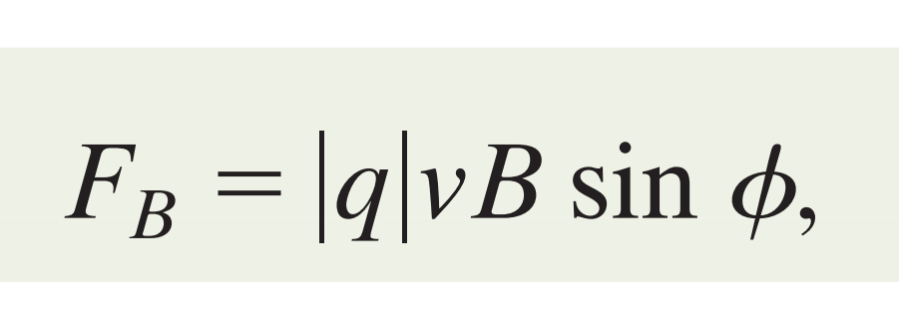
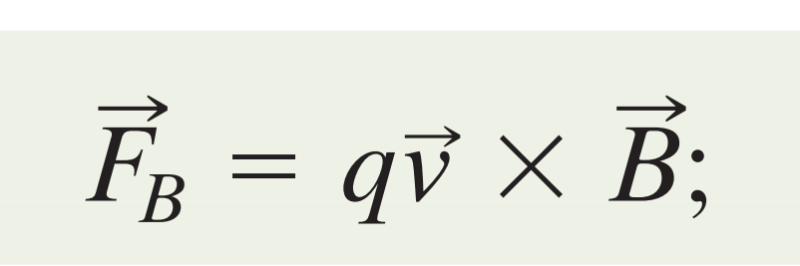
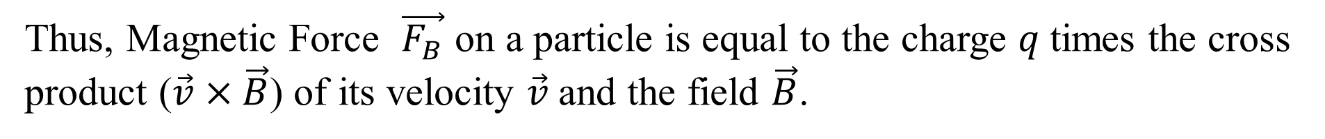
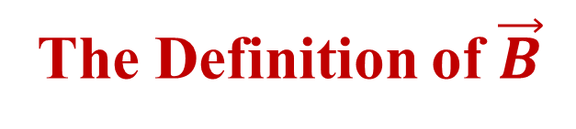
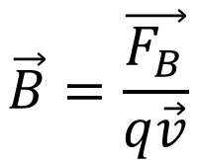
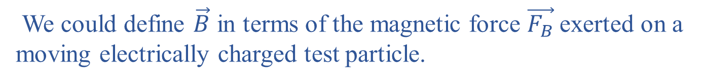
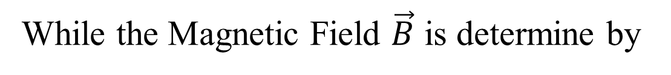
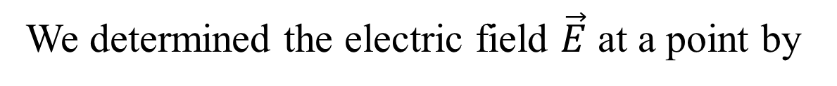
The Definition of $\vec{B}$
We determined the electric field $\vec{E}$ at a point by
We could define $\vec{B}$ in terms of the magnetic force $\vec{F_{B}}$exerted on a moving electrically charged test particle.
$$\vec{B}=\frac{\vec{F_{B}}}{q\vec{v}}$$
While the Magnetic Field $\vec{B}$ is determine by
Thus, Magnetic Force $\vec{F_{B}}$ on a particle is equal to the charge $q$times the cross product ($\vec{v}×\vec{B}$) of its velocity $\vec{v}$and the field $\vec{B}$.
Direction
Magnitude
where $∅$ is the angle between the directions of velocity and magnetic field $\vec{B}$.
Notes:
If a magnetic monopole were available, we could define it in a similar way. Because such particles have not been found, we must define in another way,

Slide 7
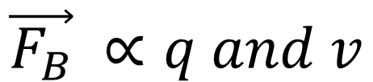
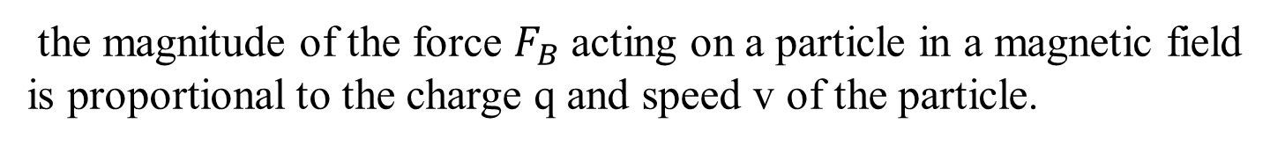
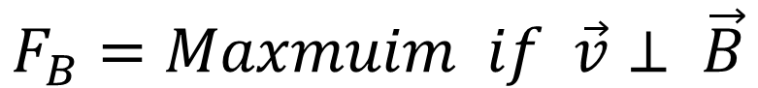
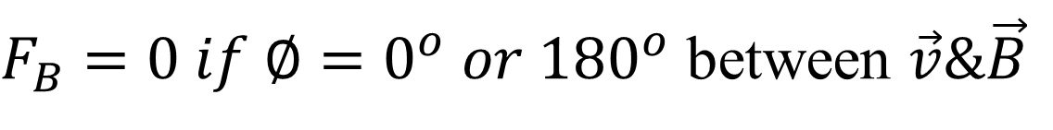
This equation tell us
the magnitude of the force $F_{B}$ acting on a particle in a magnetic field is proportional to the charge q and speed v of the particle.
$$\vec{F_{B}} ∝q and v$$
$$F_{B}=0 if q=0C (neutrial) or v=0$$
$F_{B}=0 if ∅=0^{o} or {180}^{o}$ between $\vec{v}\&\vec{B}$
$$F_{B}=Maxmuim if \vec{v}⊥ \vec{B}$$

Slide 8
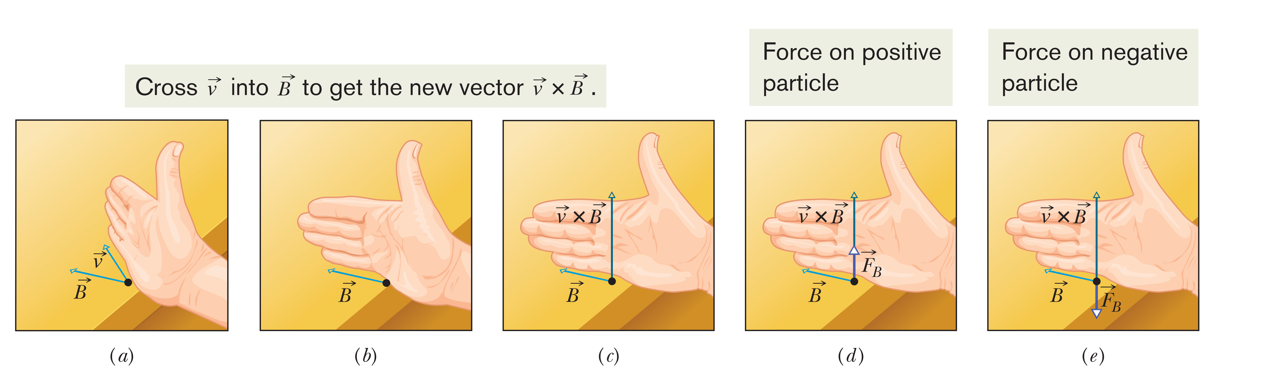
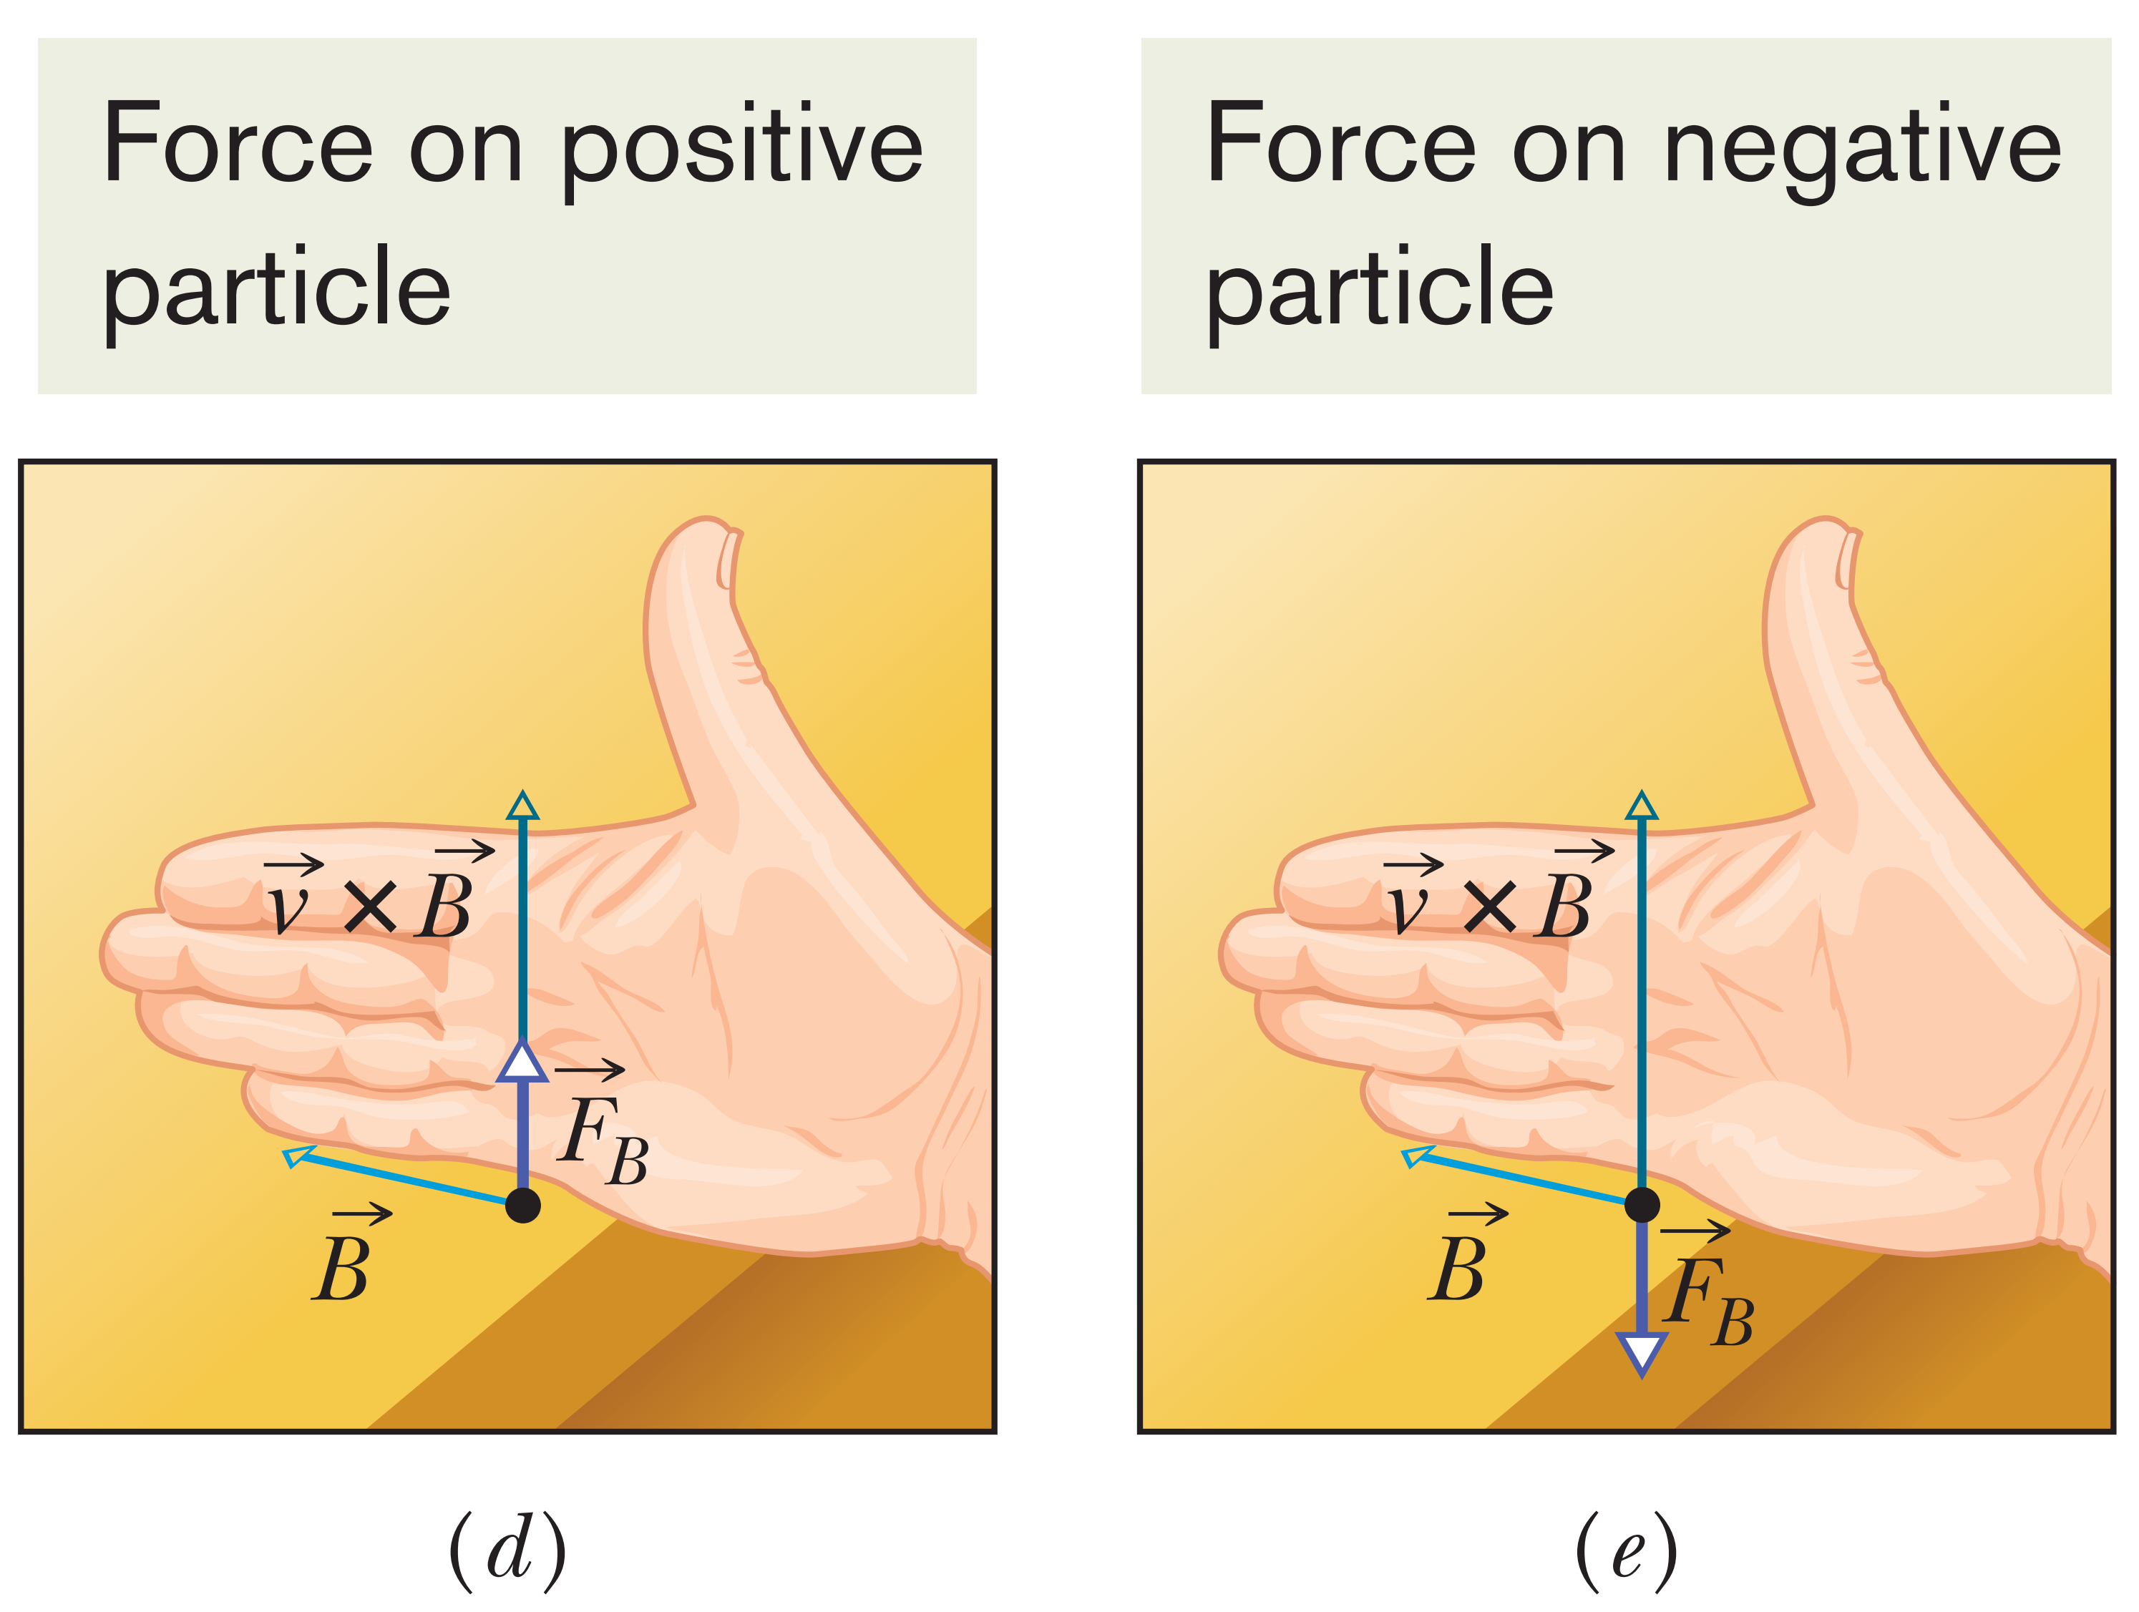

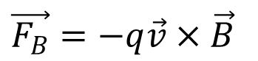
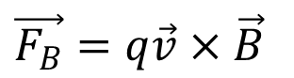
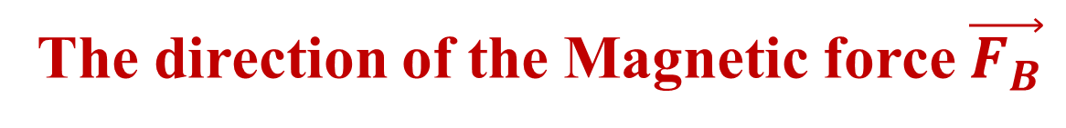
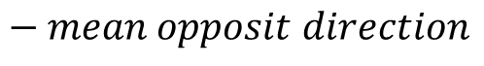
The direction of the Magnetic force $\vec{F_{B}}$
cross product $\vec{v}×\vec{B}$ is a vector that is perpendicular to the two vectors $\vec{v}$ and $\vec{B}$.
$\vec{F_{B}}=q\vec{v}×\vec{B}$
$\vec{F_{B}}=−q\vec{v}×\vec{B}$
$$− mean opposit direction$$
Notes:
The right-hand rule tells us that the thumb of the right hand points in the direction of ($\vec{v}×\vec{B}$) when the fingers sweep $\vec{v}$ into $\vec{B}$ .

Slide 9
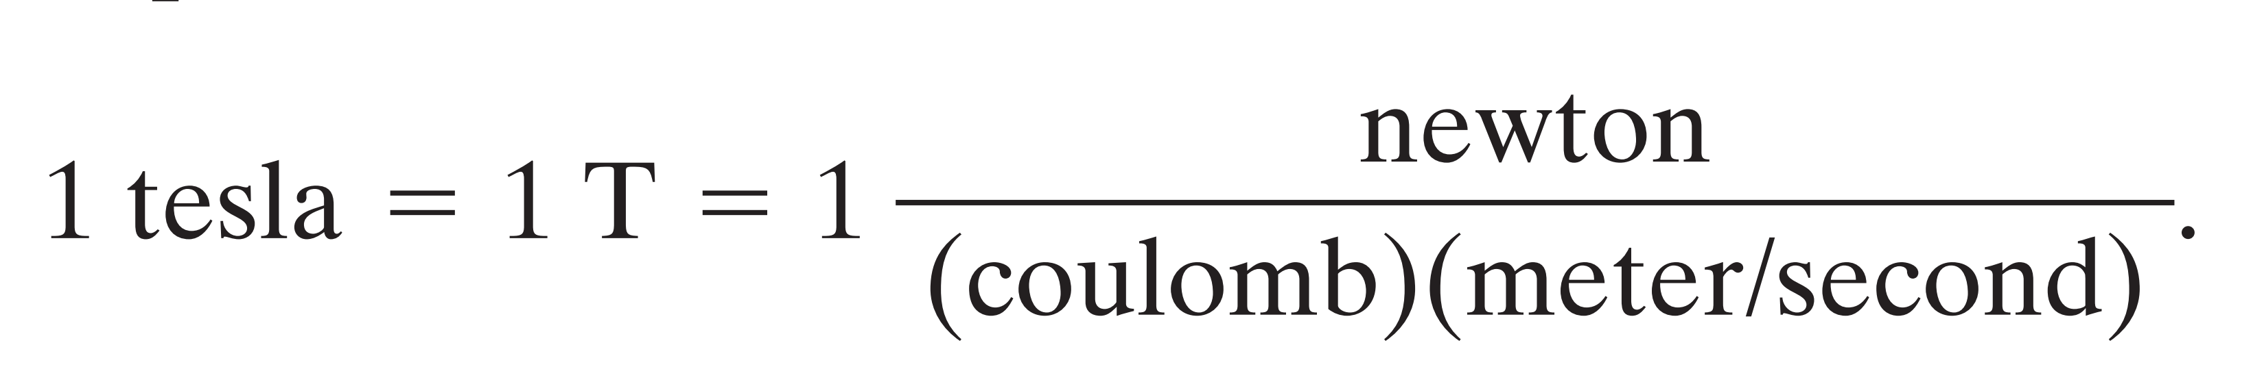
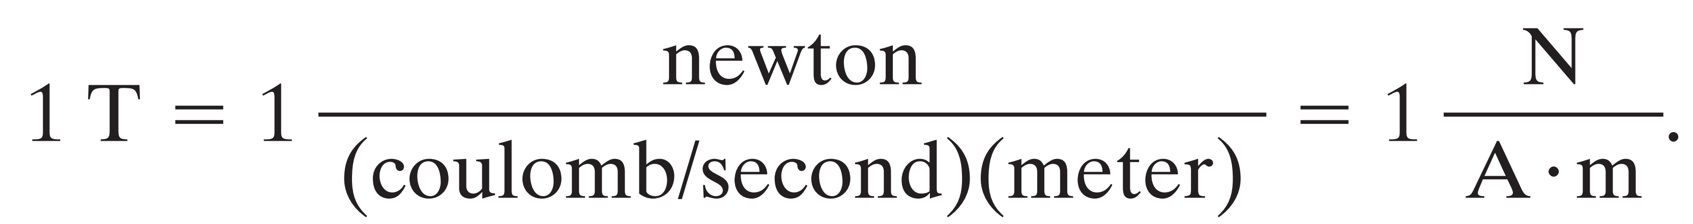
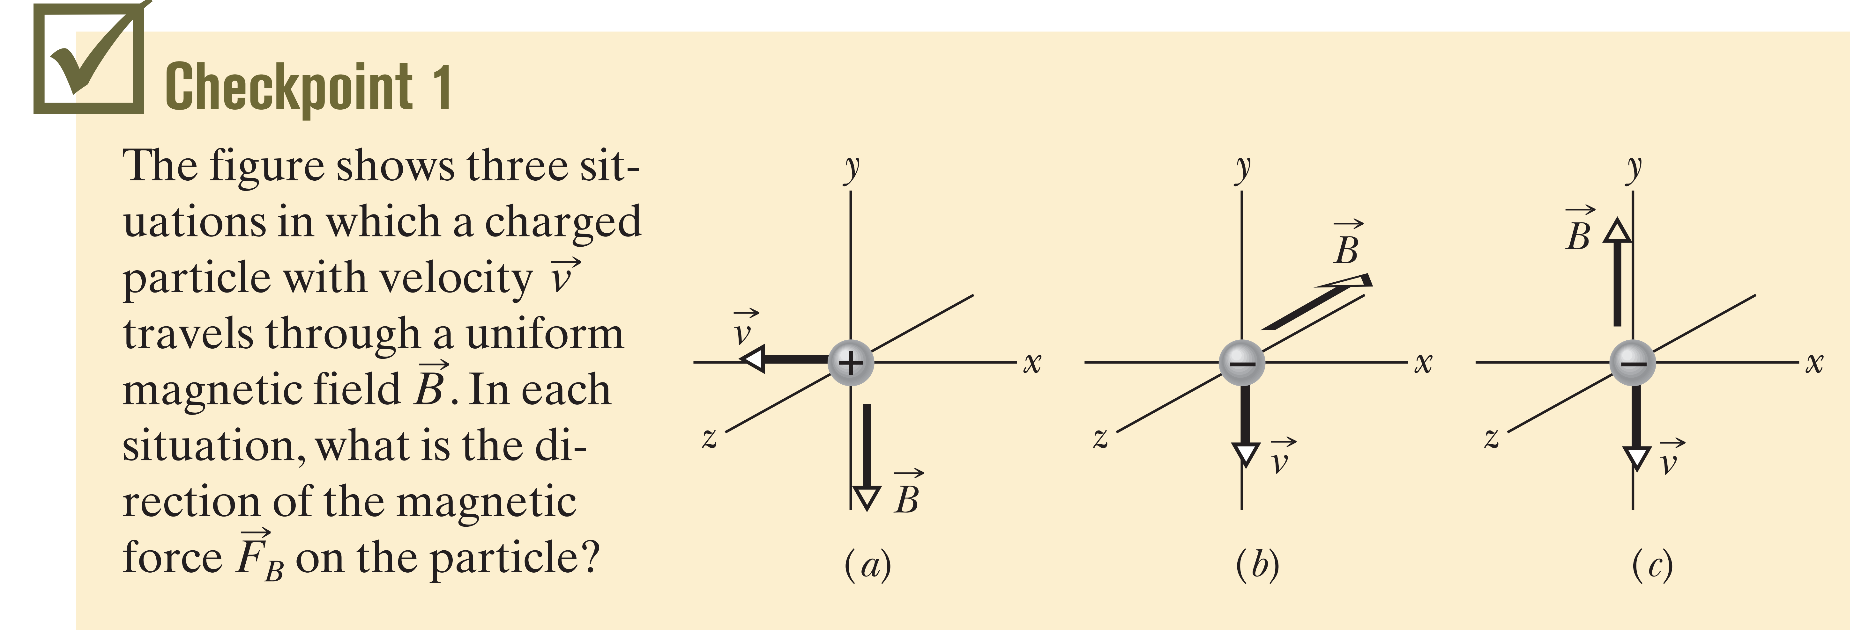
F=0
Notes:
If you apply right hand rule by sweeping your fingirs from $\vec{v}$ to $\vec{B}$, the thumb will point toward you for a. For b will be away from you because it is negative charge. The last one © the force is zero because the angle between v and B are zero.

Slide 10
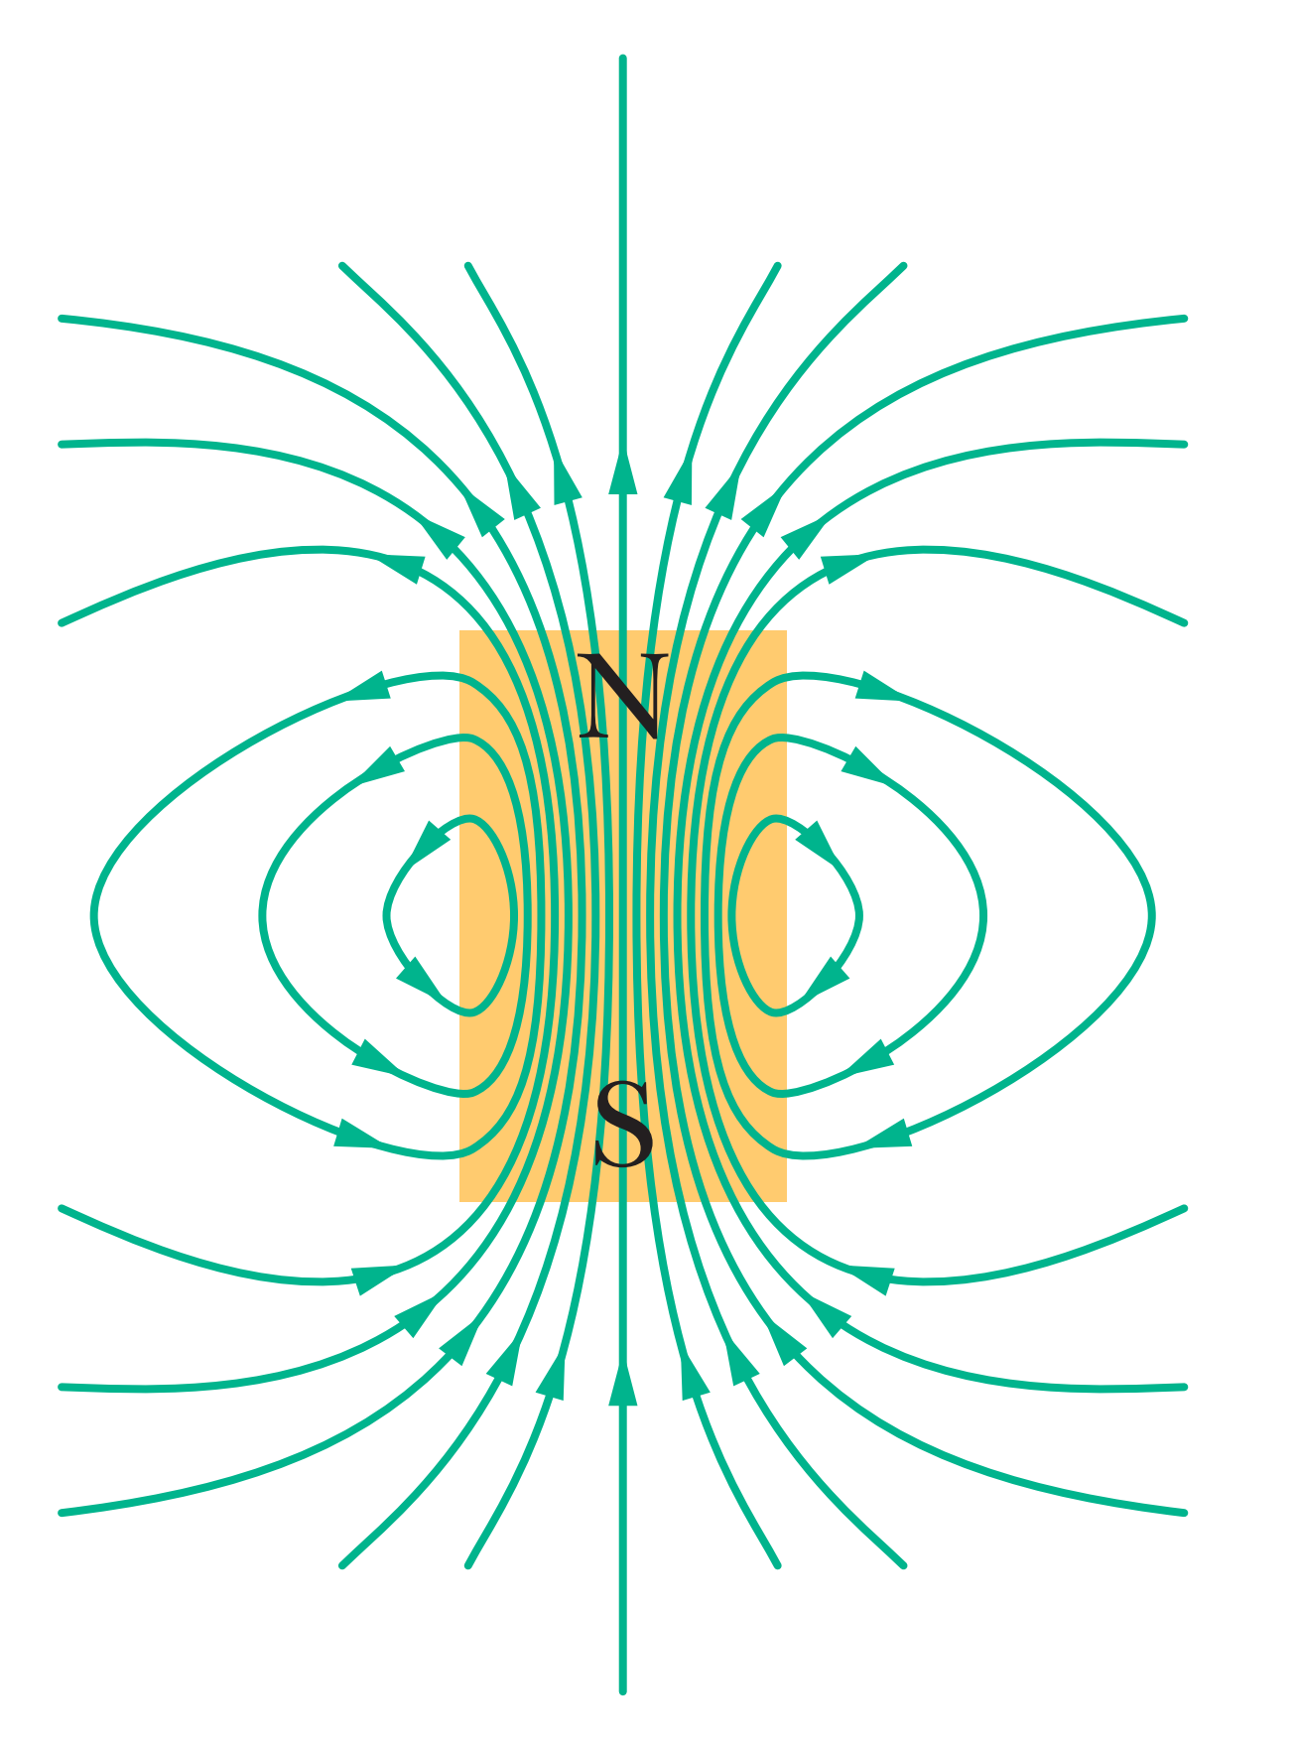

Magnetic Field Lines
The end of a magnet from which the field lines emerge is called the north pole of the magnet; the other end, where field lines enter the magnet, is called the south pole.
Notes:
We can represent magnetic fields with field lines, as we did for electric fields. The spacing of the lines represents the magnitude of —the magnetic field is stronger where the lines are closer together, and conversely.

Slide 11
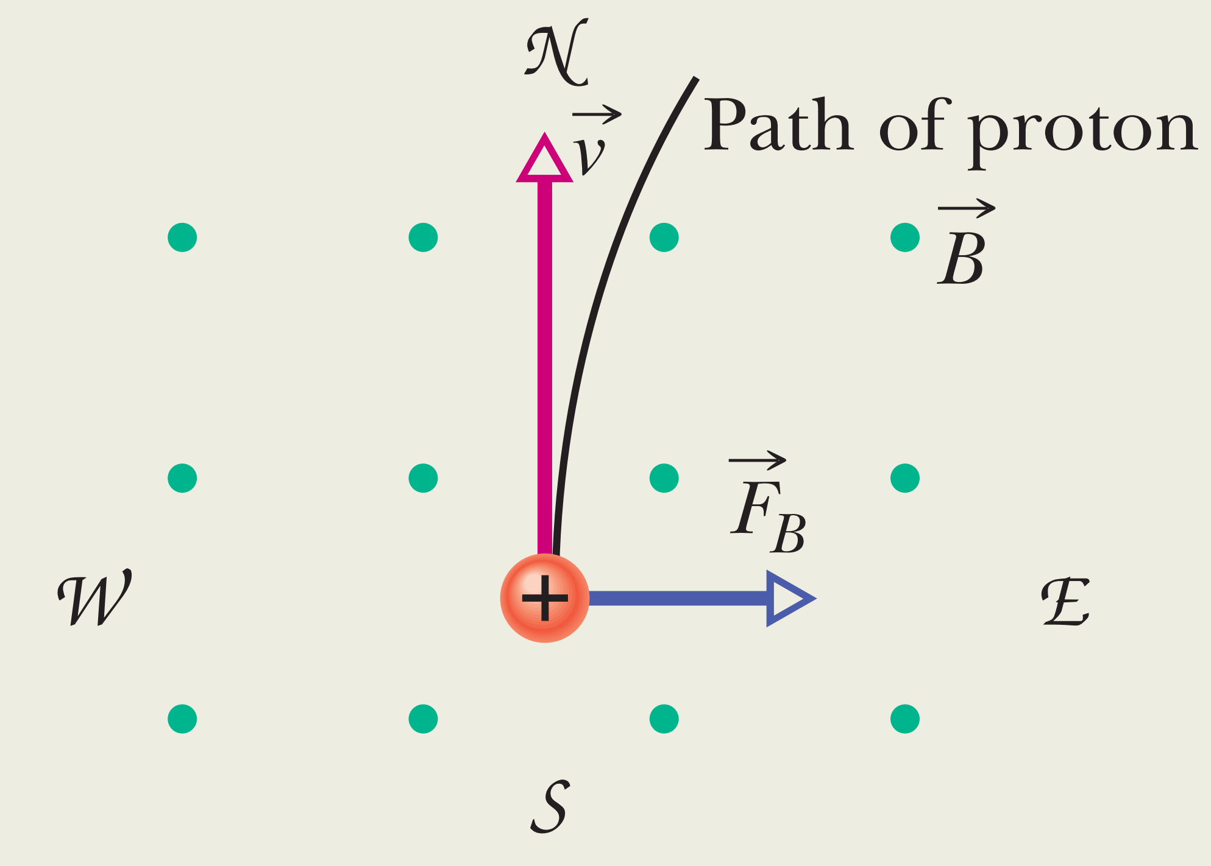
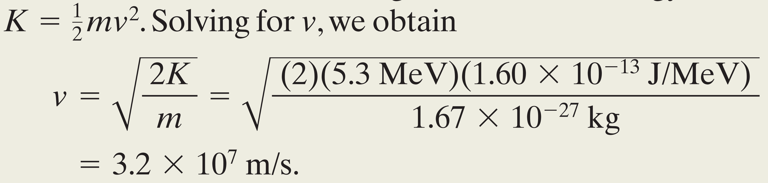
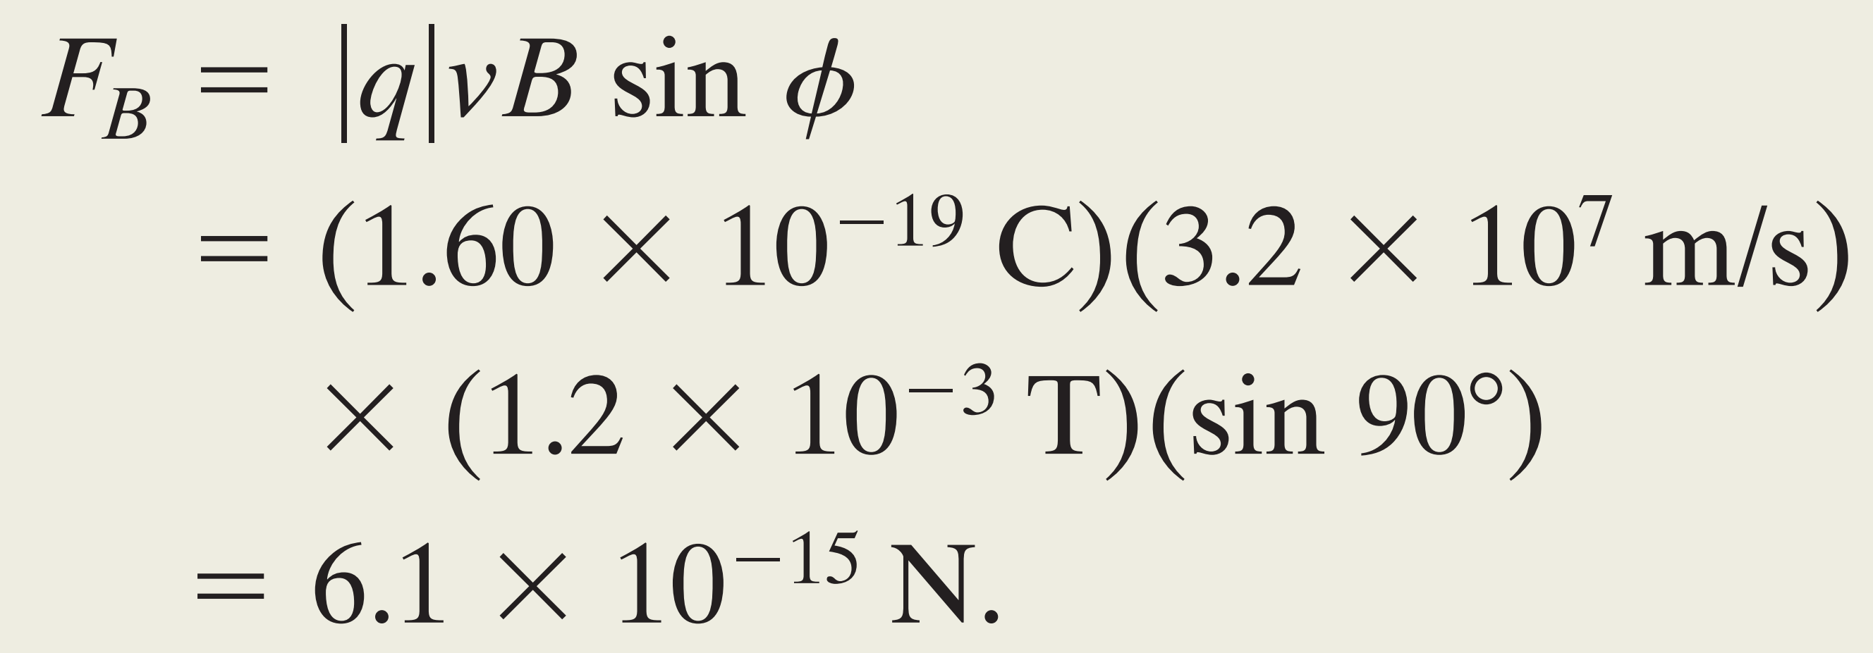
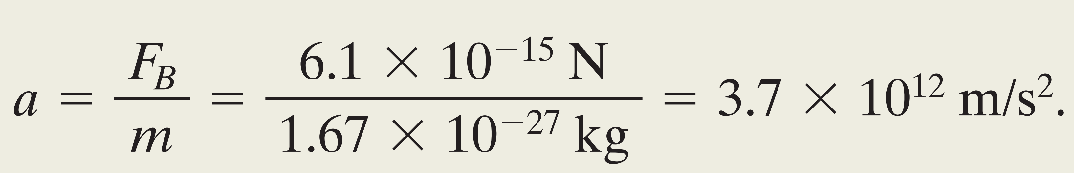
From the problem we have: $B=1.2 mT, Kinetic Energy \left(K\right)=5.3 MeV, m_{p}=1.67×{10}^{−27}kg$
We need to find the magnitude of $F=\left|q\right|vB sin∅$
Direction
This may seem like a small force, but it acts on a particle of small mass, producing a large acceleration; namely
Notes:
A uniform magnetic field , with magnitude 1.2 mT, is directed vertically upward throughout the volume of a laboratory chamber. A proton with kinetic energy 5.3 MeV enters the chamber, moving horizontally from south to north. What magnetic deflecting force acts on the proton as it enters the chamber? The proton mass is $1.67×{10}^{−27}kg$. (Neglect Earth’s magnetic field.)

Slide 12
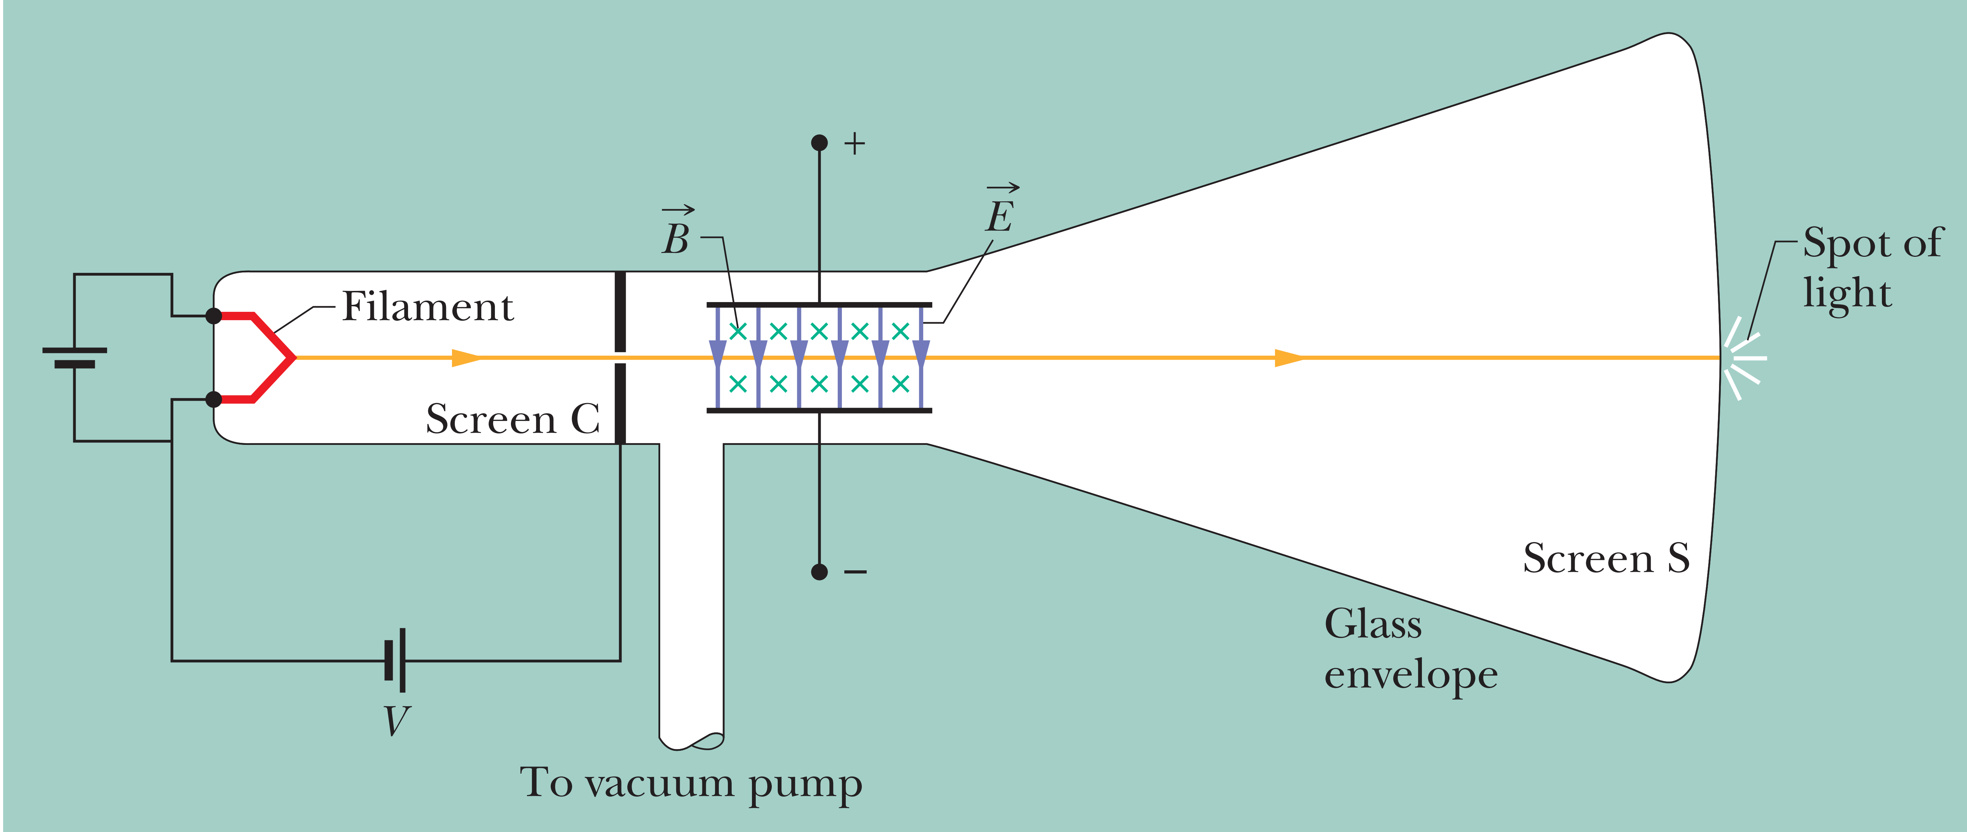
6-2 Crossed Fields: Discovery of the Electron
When an Electric field and a Magnetic field are perpendicular to each other, they are called Crossed Fields. Both the two fields can produce a force on a charged particle.
J. J. Thomson’s experimental
Crossed Fields Region
Notes:
The Filament produces a beam of charged particles. This beam will pass through cross filed region. After that it will either deflect to top or bottom sides of the screen.

Slide 13
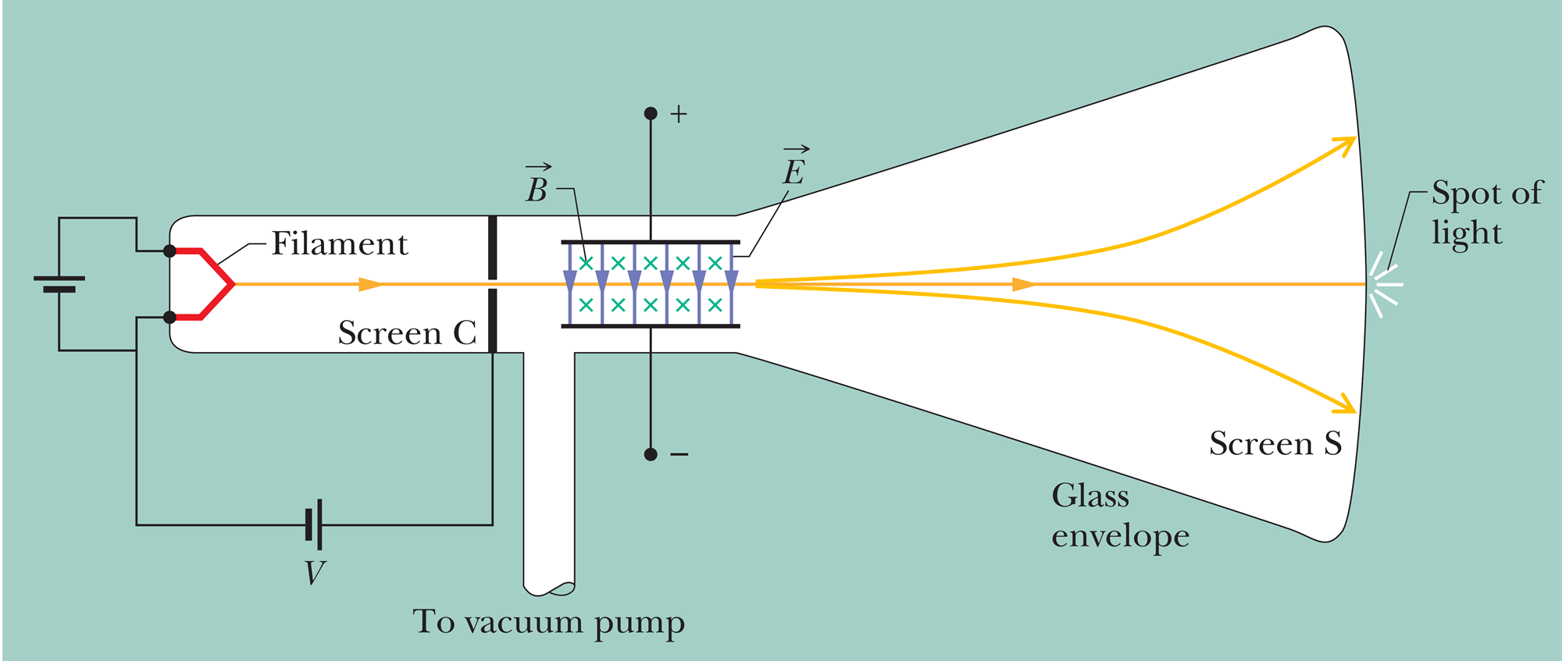
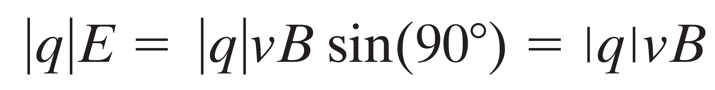
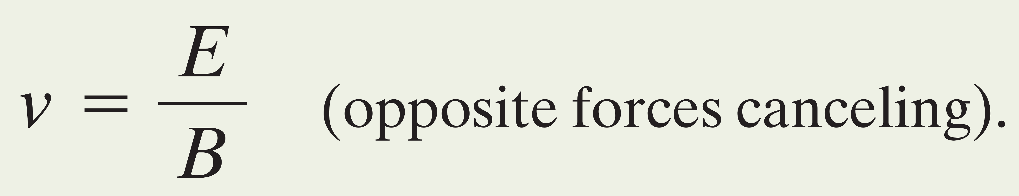
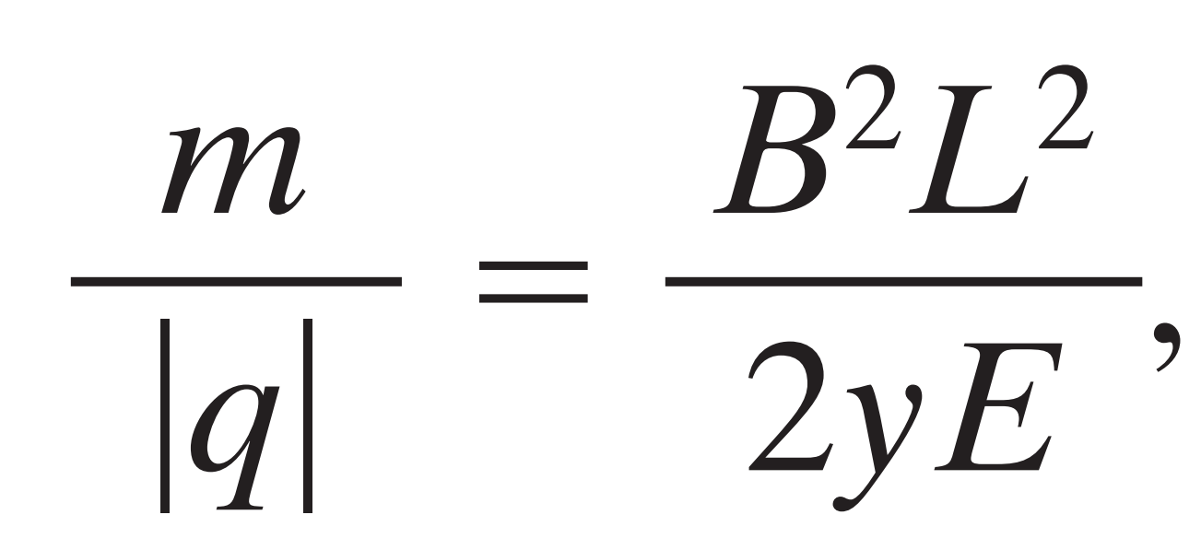
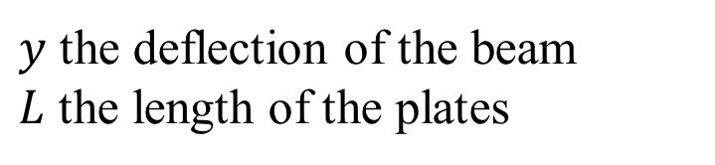
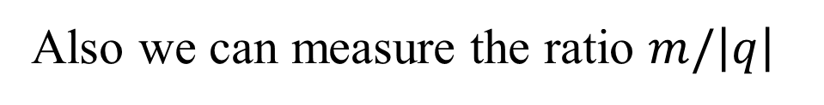
When the two fields $\vec{E} and \vec{B}$ are adjusted to be equally, so that the two deflecting forces cancel each other
We can find the speed of charged particles
Also we can measure the ratio $m/\left|q\right|$
$y$ the deflection of the beam
$L$ the length of the plates
Notes:
To make the beam incidence on the center of the screen, we need to adjust the magnitude of the E and B. Once the beam place on the center of the screen, mean we satisfy the condition.

Slide 14
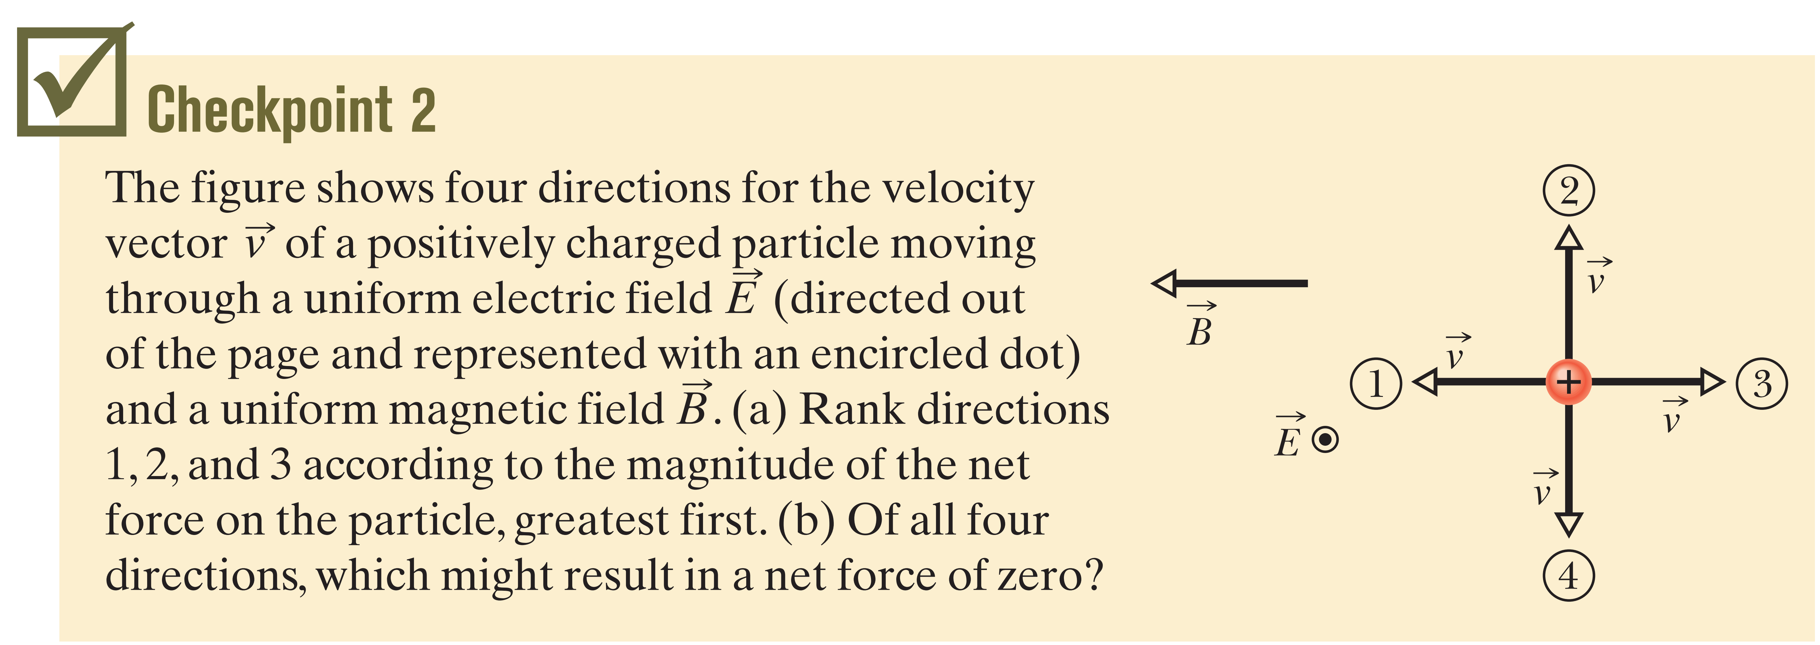
(a) 2 ( perpendicular) , then tie of 1 and 3 (zero because parallel and antiparallel)
(b) 4

Slide 15
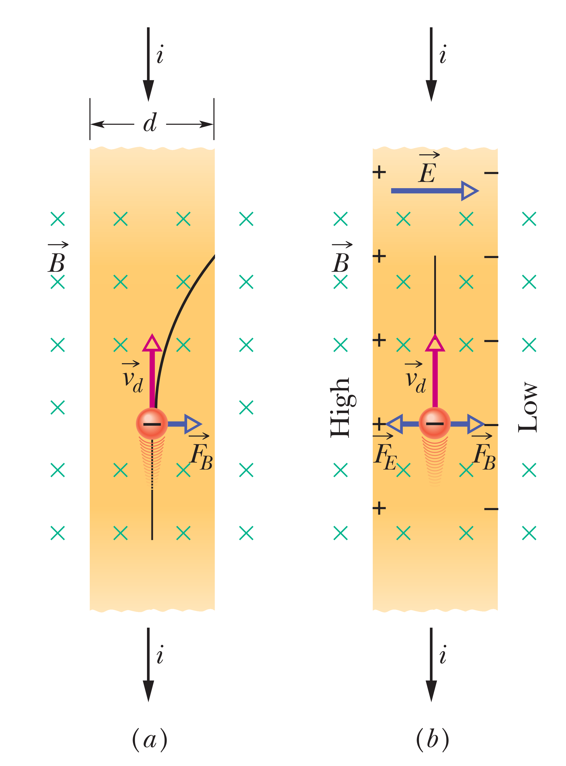
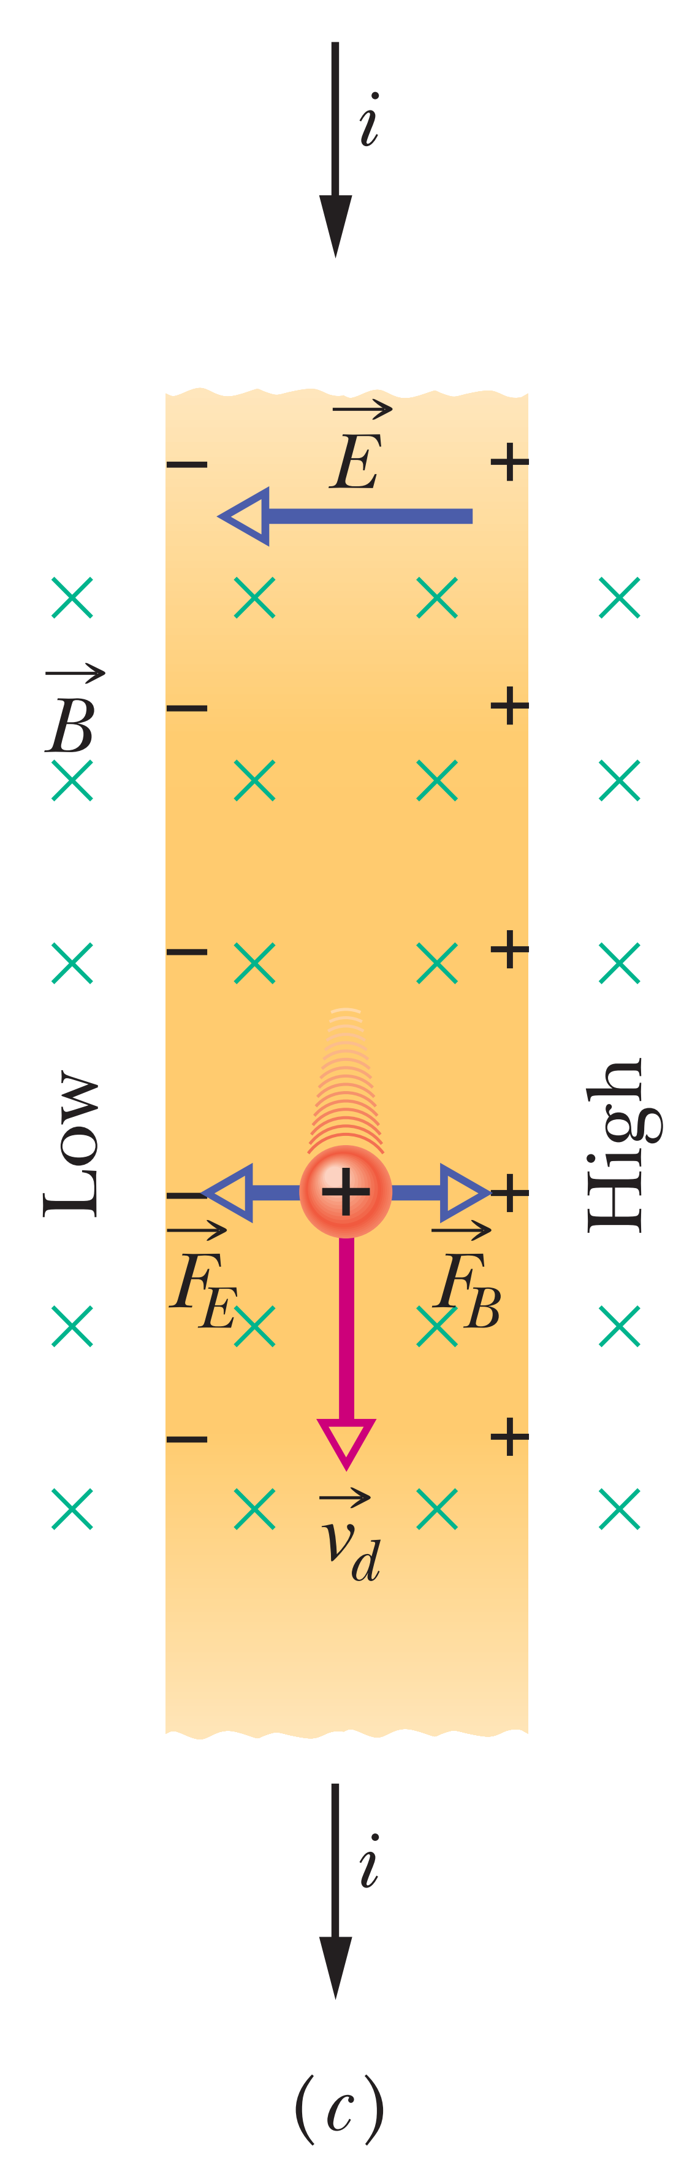
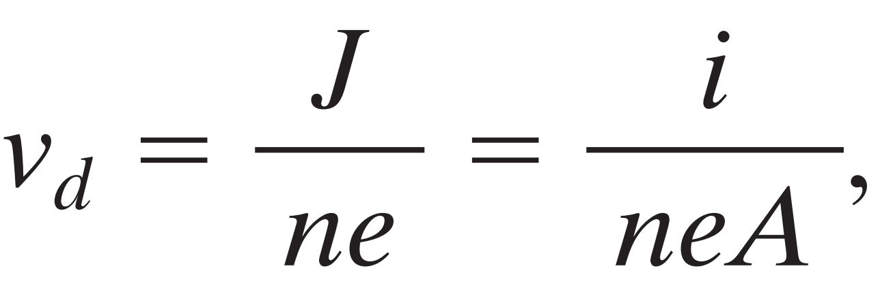
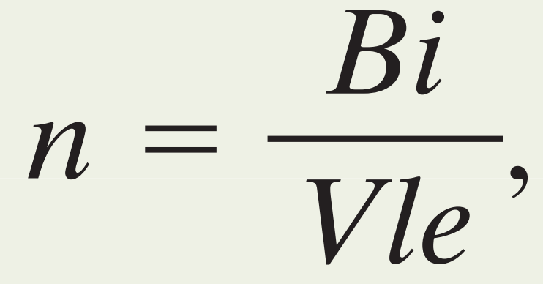
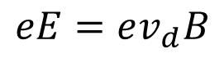
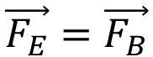
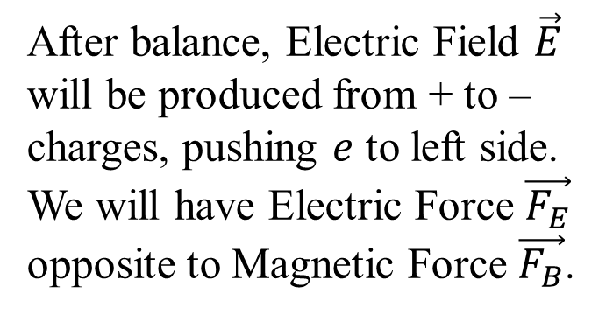
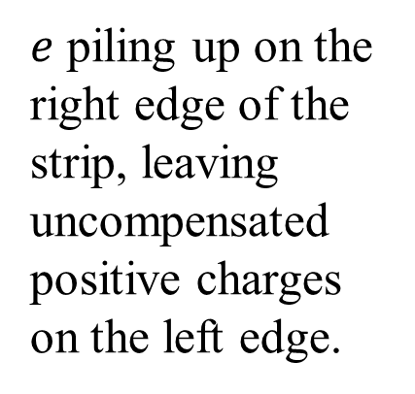
6-3 CROSSED FIELDS: THE HALL EFFECT
Hall Effect allows us to find out whether the charge carriers in a conductor are positively or negatively charged. Beyond that, we can measure the number of such carriers per unit volume of the conductor and the draft speed.
$e$ piling up on the right edge of the strip, leaving uncompensated positive charges on the left edge.
After balance, Electric Field $\vec{E}$ will be produced from + to – charges, pushing $e$ to left side. We will have Electric Force $\vec{F_{E}}$ opposite to Magnetic Force $\vec{F_{B}}$.
Positive charge carrier
Negative charge carrier
$$\vec{F_{E}}=\vec{F_{B}}$$
$$eE=ev_{d}B$$

Slide 16











Sample Problem 28.02
Edge length $d =1.5 cm$, constant velocity $\vec{v}=4.0 m/s$ in y, $B=0.05T$ in $+z$ direction
(a) Which cube face is at a lower electric potential and which is at a higher electric potential because of the motion through the field?
$$−q$$
$$\vec{v}⊥\vec{B}$$
$$\vec{\vec{v}×\vec{B}}⊥ \vec{v}\&\vec{B}$$
$$e=−q$$
$\vec{F_{B}}=−q\vec{v}×\vec{B}$
$$\vec{F_{B}} ⇄(\vec{v}×\vec{B})$$
acting on the electron
Notes:
The Figure shows a solid metal cube, of edge length $d =1.5 cm$, moving in the positive $y$ direction at a constant velocity of magnitude $4.0 m/s$. The cube moves through a uniform magnetic field of magnitude $0.050 T$ in the positive $z$ direction.

Slide 17
















(b) What is the potential difference between the faces of higher and lower electric potential?
Once
$\vec{F_{E}}=\vec{F_{B}}$ condition achieves
low
high
$$\vec{F_{E}}=q\vec{E}$$
$$\vec{E} from+to −$$
$$e=−q$$
The accumulation of charges with time till reach equilibrium.
$$\vec{F_{E}}=−q\vec{E}$$
$E=vB$, We have $V=Ed$
$$\vec{F_{E}}⇆\vec{E}$$
$$\vec{F_{E}}=\vec{F_{B}}$$
$$\vec{F_{E}}⇆\vec{F_{B}}$$

Slide 18



6-4 A CIRCULATING CHARGED PARTICLE
If a charged particle with constant speed $\vec{v}$ move through a uniform perpendicular magnetic field $\vec{B}$, the charged particle will move in “Circular Path”.
e
Positive particle moves in counterclockwise direction, Negative particle moves in clockwise direction.
Notes:
This schematic shows the path of the charged particle entering the perpendicular magnetic field.

Slide 19
















Magnetic Force $\vec{F}=q \vec{v}×\vec{B}$
, when $θ={90}^{o}$,
$$F=\left|q\right|vB$$
Using Newton’s second law $\vec{F}=m\vec{a}$ for uniform circular motion to find
centripetal force:
$$T$$
We can drive this equation to find out :
The radius of the circular path
$$r$$
$$ω$$
The period T
The frequency f
$$1f=1ω$$
The angular frequency $ω$

Slide 20






Helical Paths
If the velocity of a charged particle has a component parallel to the (uniform) magnetic field, the particle will move in a helical path about the direction of the field vector.
Uniform $\vec{B}$
The parallel component ($v_{||}$) determines the pitch p of the helix—that is, the distance between adjacent turns
The direction of particle
The perpendicular component ($v_{⊥}$) determines the radius ($r$) of the helix.

Slide 21




Nonuniform $\vec{B}$
Area with small $r$
Indicate strong field
Indicate strong field
Area with large $r$
Indicate weak field

Slide 22


Electron follows the smaller circle
Proton follows the larger circle
b) Positive particle is counterclockwise direction,
Negative particle is clockwise direction.

Slide 23








Sample Problem 28.04
An electron with a kinetic energy of 22.5 eV moves into a region of uniform magnetic field of magnitude $4.55×{10}^{−4}T$. The angle between the directions of $\vec{B}$ and the electron’s velocity $\vec{v}$ is 65.5°. What is the pitch of the helical path taken by the electron?
$$Distance=speed ×time$$
$$P=v_{||}×T$$
$$P=v cos∅ \frac{2πm}{\left|q\right|B}$$
$$={65.5}^{o}$$
$$K=\frac{1}{2}mv^{2}$$
$$v=2.81×{10}^{6} m.s$$
$$p=\left(2.81×{10}^{6}\frac{m}{s} \cos{65.5}\right) \frac{2π\left(9.11×{10}^{−31} kg\right)}{\left(1.6×{10}^{−16}C\right)\left(4.55×{10}^{−4}T\right)}=9.16cm$$

Slide 25
-
+
+

Slide 26

-

Slide 27





$$B$$
$$v$$
$$v$$
$$B$$

